Slide 1
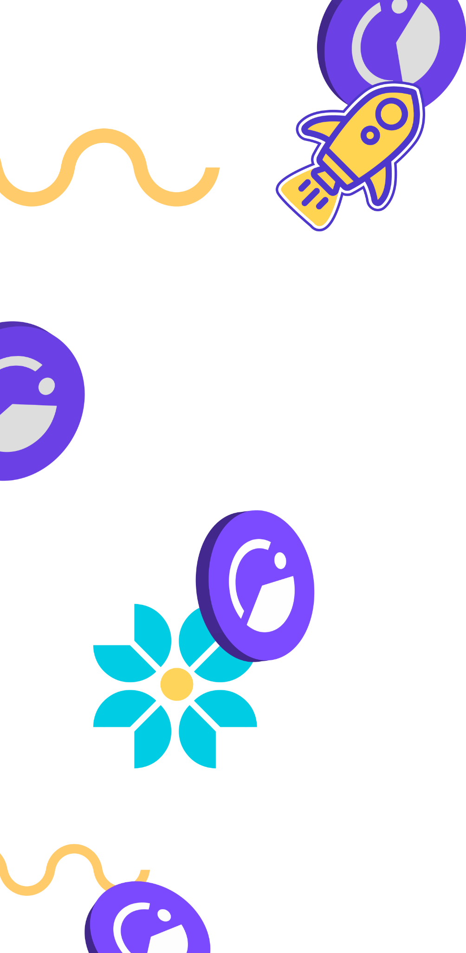
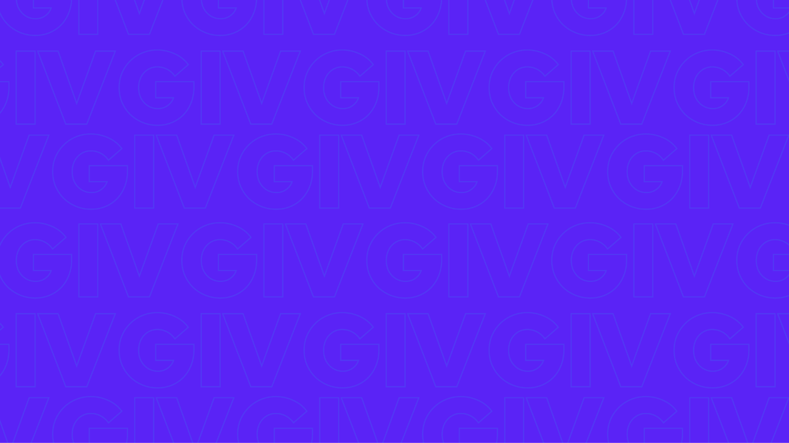
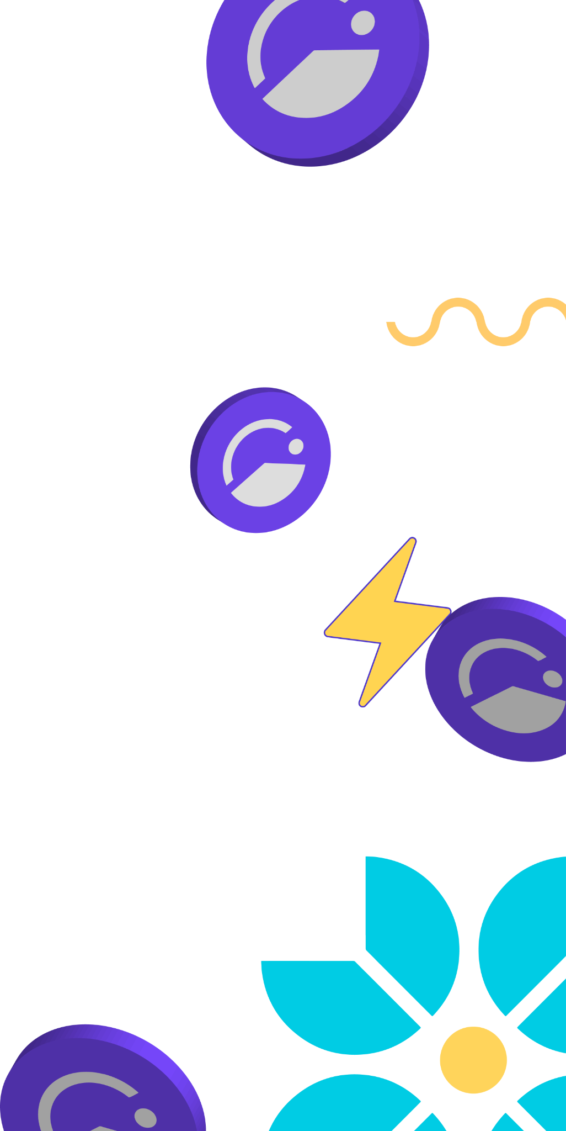

Giveth is rewarding and empowering those
who give to projects, to society, and to the world!
Giveth is rewarding and empowering those who give to projects, to society, and to the world!

Slide 2
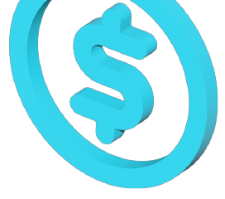
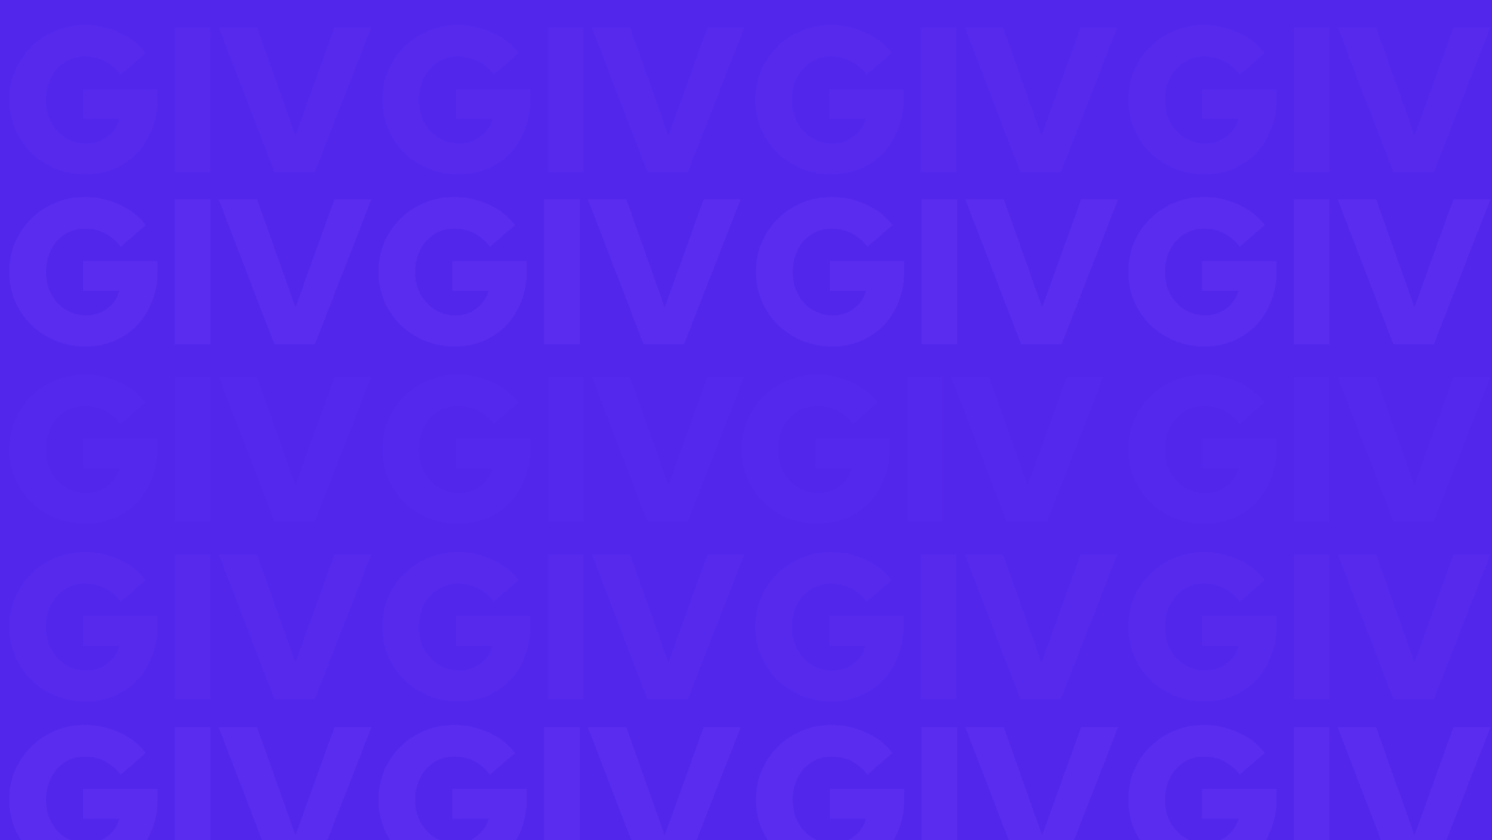

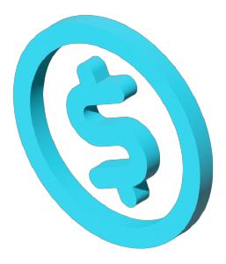




The Opportunity
$25 trillion/yr
SPENT worldwide on Public Goods Over 25x Total Crypto Market Cap
Griff Green @thegrifft

Slide 3

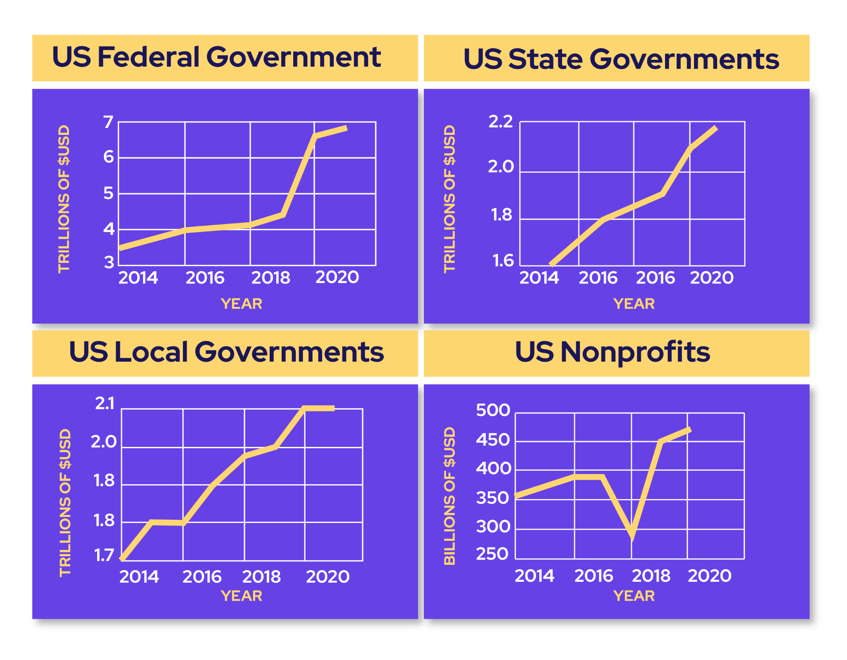
The Public Goods Space Is Ripe For Disruption
Public goods are the most overlooked web3 opportunity.
Federal, state, and local governments in just the US spent $10 TRILLION in 2021, and this cost is growing every year with no clear solution in sight: 10x the crypto market cap, not invested, SPENT!
US philanthropists donated almost 500B USD in 2020, but our collective needs aren’t being adequately met using these systems.
We have the opportunity to disrupt this sector GLOBALLY & Giveth is positioned to lead the way.

Slide 4

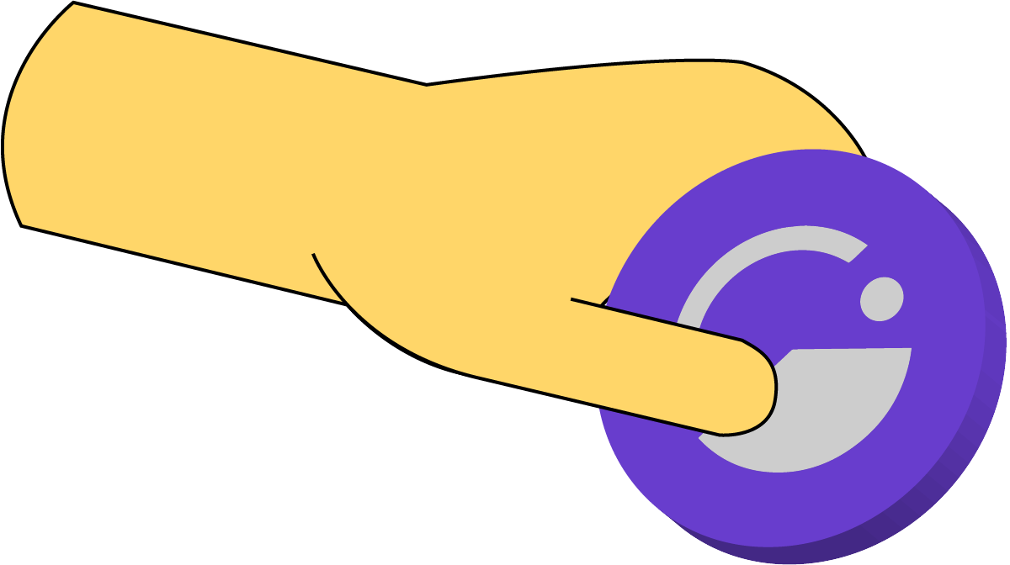

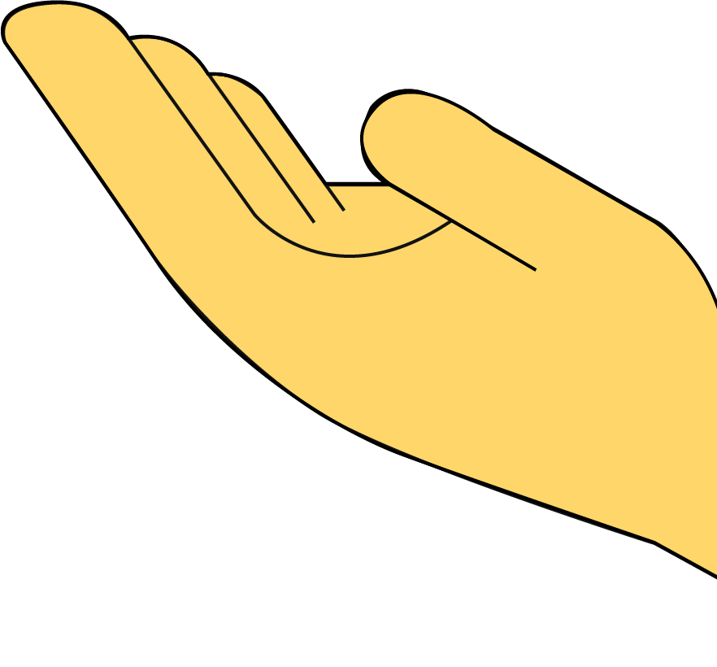
Where do we start?
When governments fail to provide Public Goods that are in demand, people start nonprofits.
Griff Green @thegrifft

Slide 5
Nonprofits
~$500 Billion/yr
is donated in the US alone
Griff Green @thegrifft

Slide 6

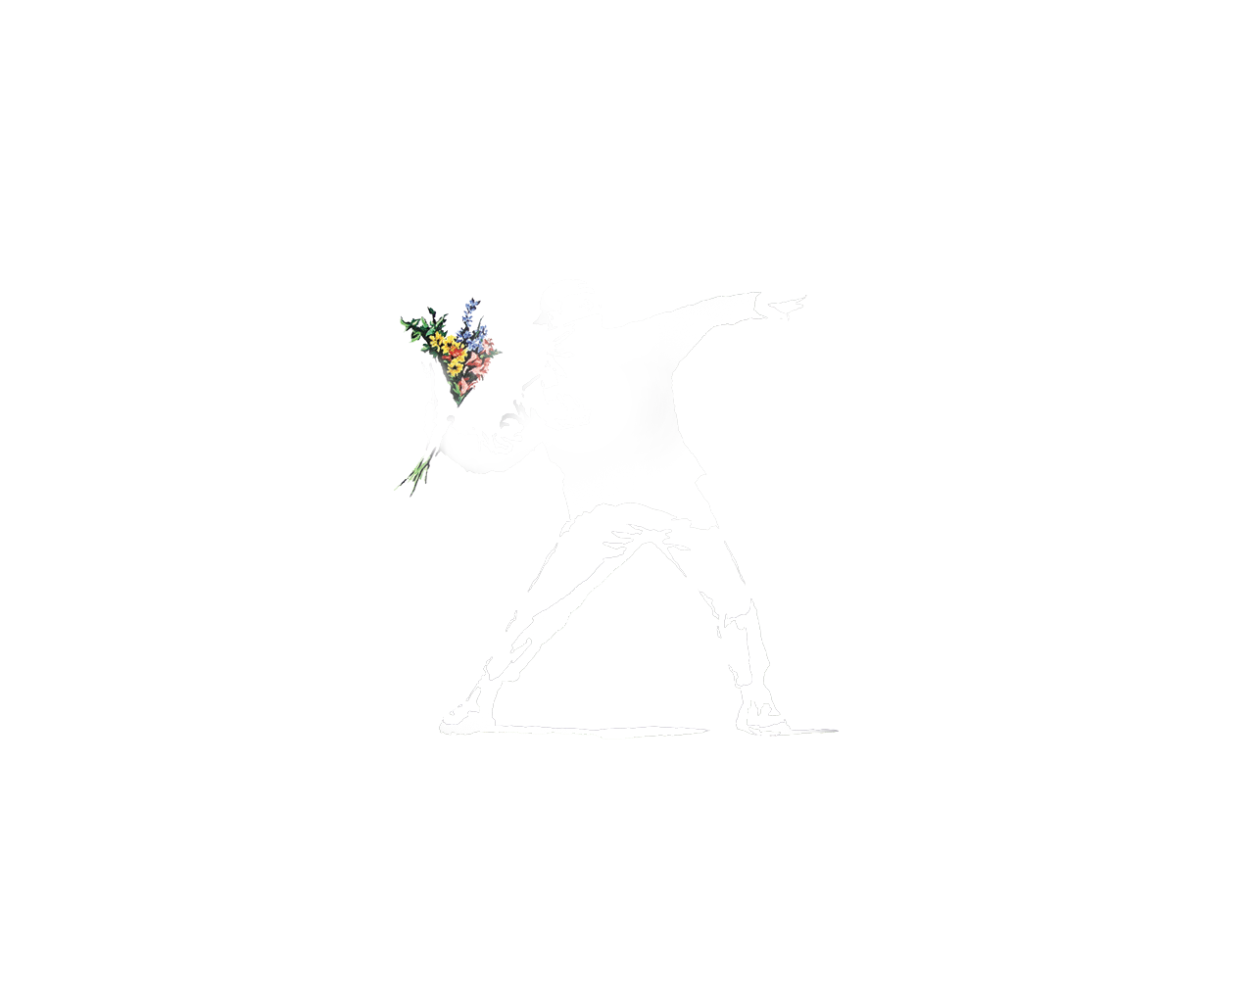
The 30 year Giveth Roadmap
Evolve the nonprofit space
Provide the government services that people actually want
Top down control loses legitimacy and fades away peacefully
Griff Green @thegrifft

Slide 7
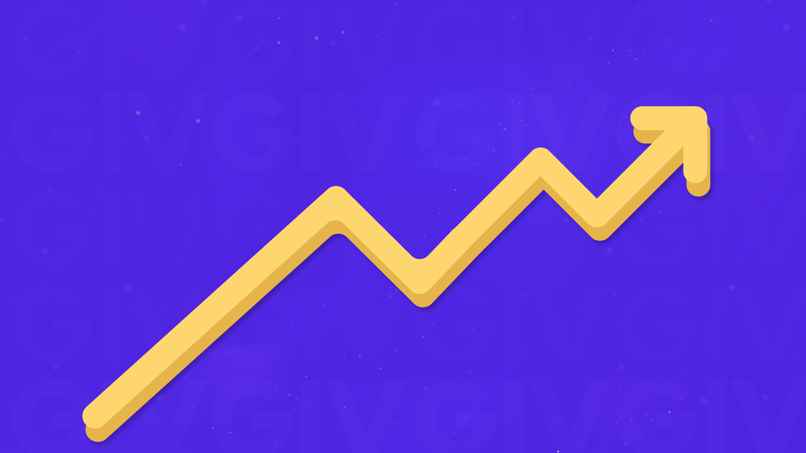
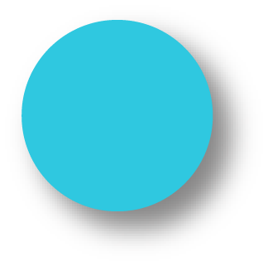
The 3 year Giveth Roadmap
GIVpower
Support projects & earn
GIVbacks
Donor rewards
Our DApp, unstoppable Donation Application
GIVfi
Revenue models integrated
We are here
Gurves
Projects become Impact DAOs collateralized by GIV
Griff Green @thegrifft

Slide 8
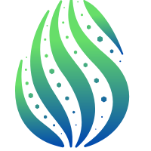

History of Success
‘16
‘17
‘18
‘19
‘20
‘21
• Founded by Griff Green, Jordi Baylina, and members of the White Hat Group
• Created Minime Token contract (used by Aragon, Status, etc. and forked by Compound)
• First project website launch
• Donation Application (DApp) launched - enabling traceable & accountable donations to for-good campaigns
• Giveth officially introduced as a DAC, introducing a new governance structure for the DAO
• Creation of Reward DAO: a system to reward contributors for their work, now called Praise
• Organized ScalingNow! Conference to address Ethereum scaling issues
• Won 1st place at Edcon’s Super Demo in Toronto
• Launched Giveth Trace in beta, one of the first multichain DApps with a bridge to Rinkeby
• Supported the launch of xDai, as one of 4 founding validators
• Commons Stack spun out of Giveth: a partner project designed to help with Giveth’s vision of Regenerative Microeconomies
• Augmented Bonding Curve designed
• Conviction Voting designed
• Work begun on building Token Engineering Commons
• Giveth Trace exigraduated out of beta with better functionality and streamlined UX
• Giveth’s reputation DAO launched using “Soul-bound tokens” now known as nrGIV DAO
• New donation application built with simple peer-to-peer donations on both Mainnet and xDai (now Gnosis Chain)
• Launch of GIVeconomy and GIV. Live: GIVfarm, GIVstream and Conviction Voting
• Giveth now governed by holders of GIV and nrGIV
• Giveth in full-swing with functioning tokenization platform

Slide 9


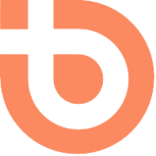
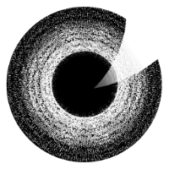

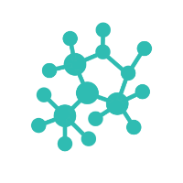
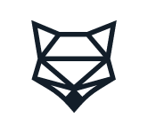
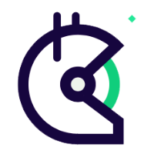

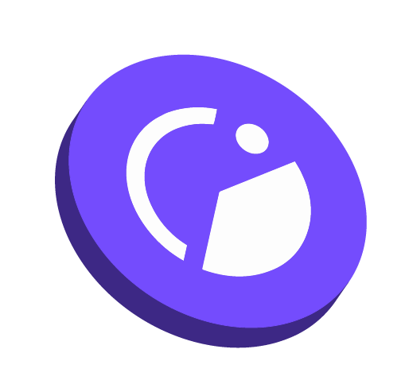

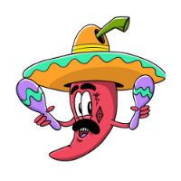
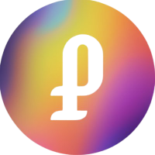

Our partners
1Hive
Commons Stack
Aragon
BrightID
The DAOist
ICHI
DappNode
Gnosis
ShapeShiftDAO
Gitcoin
Token Engineering Commons
Maker DAO
MetaCartel
Panvala
PrimeDAO
and more…

Slide 10
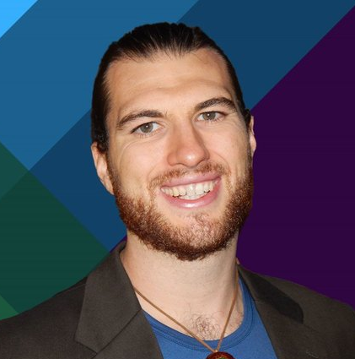
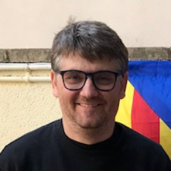
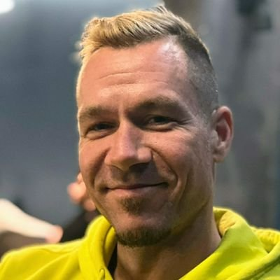
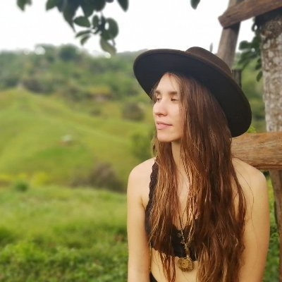
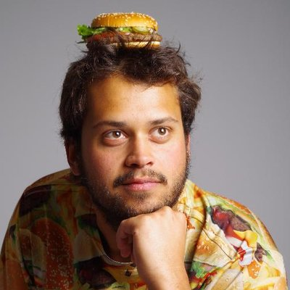

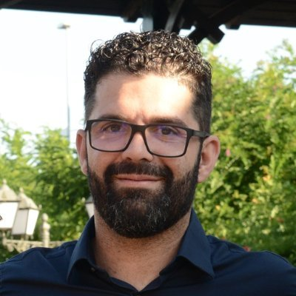
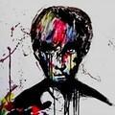
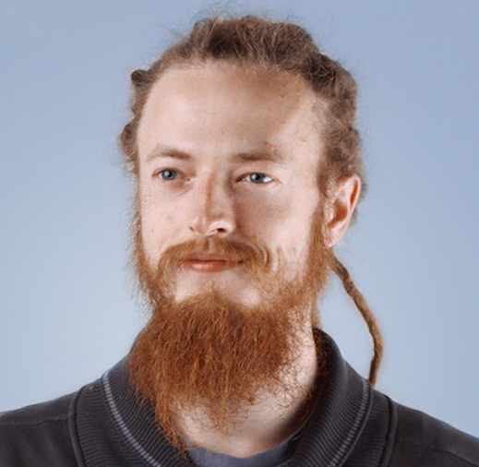
Giveth DAO
Griff Green
co-Founder of the Commons
Stack, Giveth.io. Also co-founder of DAppNode and White Hat Group (WHG).
Jordi Baylina
co-founder of Giveth, DAppNode
and founder and technical lead of Polygon Hermez’ zkEVM and iden3.
Marko Prljic
Product and UX design lead at
Giveth, co-founder of General Magic.
Lauren Luz
Giveth communications lead and GIVeconomy product manager.
Mitch @divine_comedian
DAO steward, DeGov expert,
DevOps and development assistant.
Willy Ogorzaly
Head of Decentralization at Fox Foundation. Former CEO @bitfract acq: ShapeShift @JustLegal acq: DigitalTown.
Eduardo Antuña
DAppNode co-founder and
project lead. Ethereum DevOps and Solidity developer.
Sem @404ouch
Software engineer at 1Hive, Giveth.
Smart contract developer. Building GIVpower.
Oleksii Matiiasevych
Ethereum architect,
smart contracts engineer.
…and 50+ Giveth contributors

Slide 11
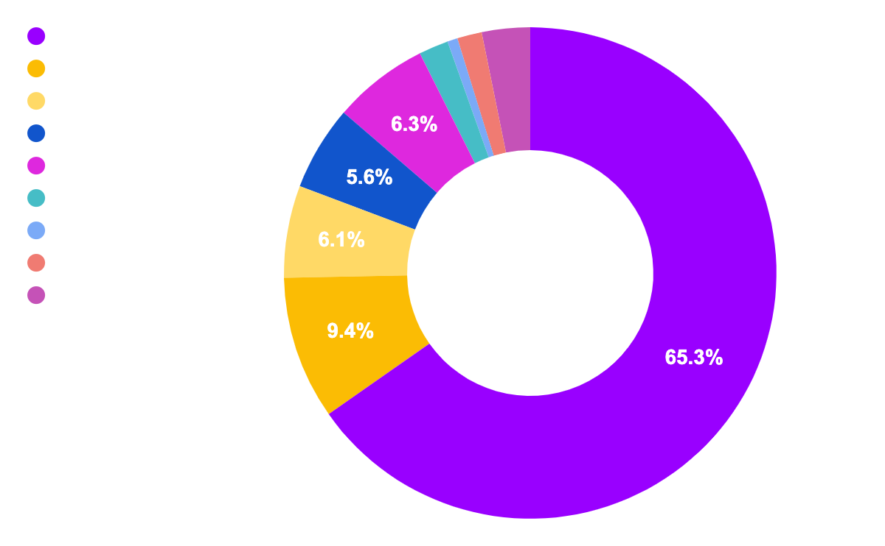
86% of our unique donors joined since March ‘21, and the numbers continue to grow!
Giveth in numbers
Total donated: $3,093,149 USD
# of projects: 1,562
# of donations: 14,327
# of unique donors: 4,168
$ 3,093,149
Total
Top 10 categories raised by total

Slide 12
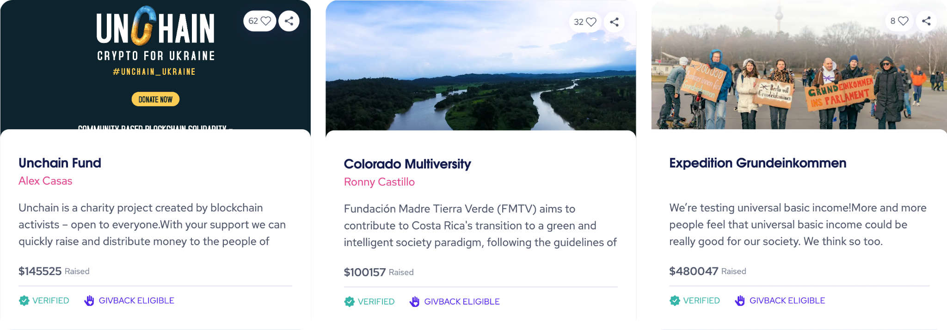
We are making global impact

Slide 13
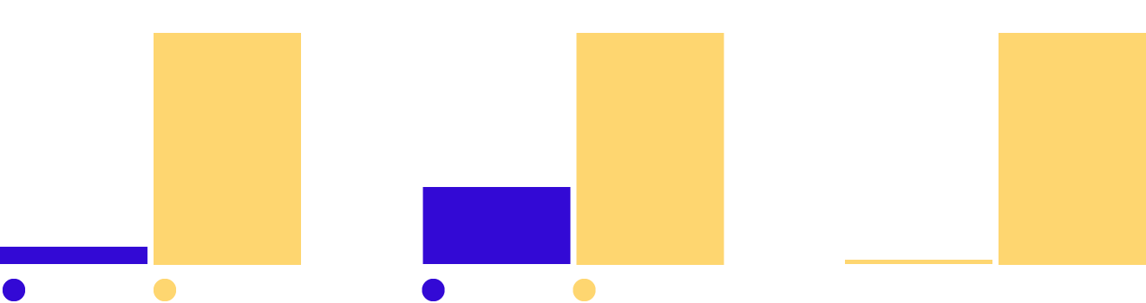
45% of crypto users donate at least $1,000 to charity yearly…
…while only 33% of the general investor population gives $1,000 or more to charity annually. This fact suggests that the average crypto donor is uniquely generous, as compared to the average cash donor.
Given the crypto market outlook, user and nonprofit adoption growth, and innovations in fundraising, crypto has the potential to become the most powerful philanthropic force on the planet in the years ahead.
In 2021, the largest source of charitable giving came from individuals, who gave $326.87 billion, representing 67% of total USD giving.
Overall Cryptocurrency Donation Volume
Total Annual Volume of Cryptocurrency Donations (USD)
The Value of an Average Crypto Donation
Mean Average Cryptocurrency Donation Size
Donations: Crypto vs. Cash
Average Cryptocurrency Donation vs. Average Online Cash Donation
16x
236%
82x
Source: 1. Growing popularity of cryptocurrency could fuel charitable giving (Fidelity Charitable) 2. Charitable Giving Statistics 3. The giving block annual report

Slide 14
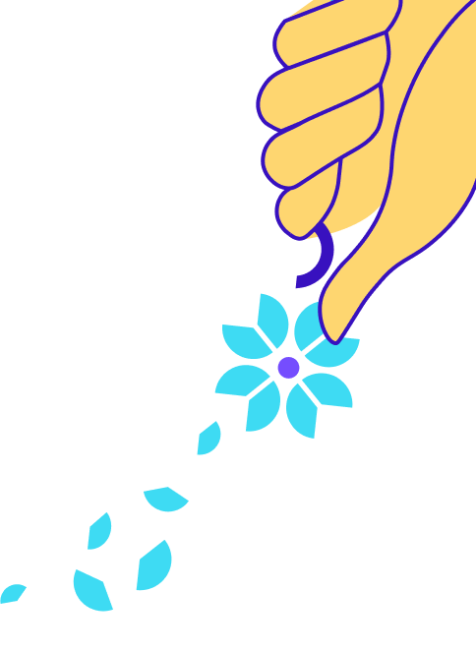




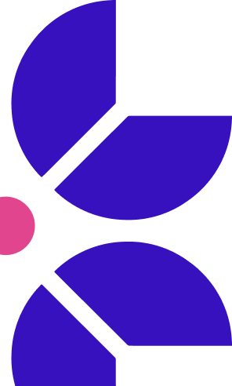
Using web3 to evolve philanthropy
Giveth has the best donation platform in the world & more!
Donations go to projects where they keep 100% of proceeds.
Donors are rewarded with GIVbacks. (Incentive program that rewards donors with GIV.)
GIV holders can earn a yield participating in the GIVeconomy.
ReFi organizations can build liquidity with Regen Farms.
Our community is focused on Building the Future of Giving using blockchain technology. Our intention is to support and reward the funding of public goods by creating open, transparent, and free access to the revolutionary funding opportunities available within the web3 ecosystem.

Slide 15
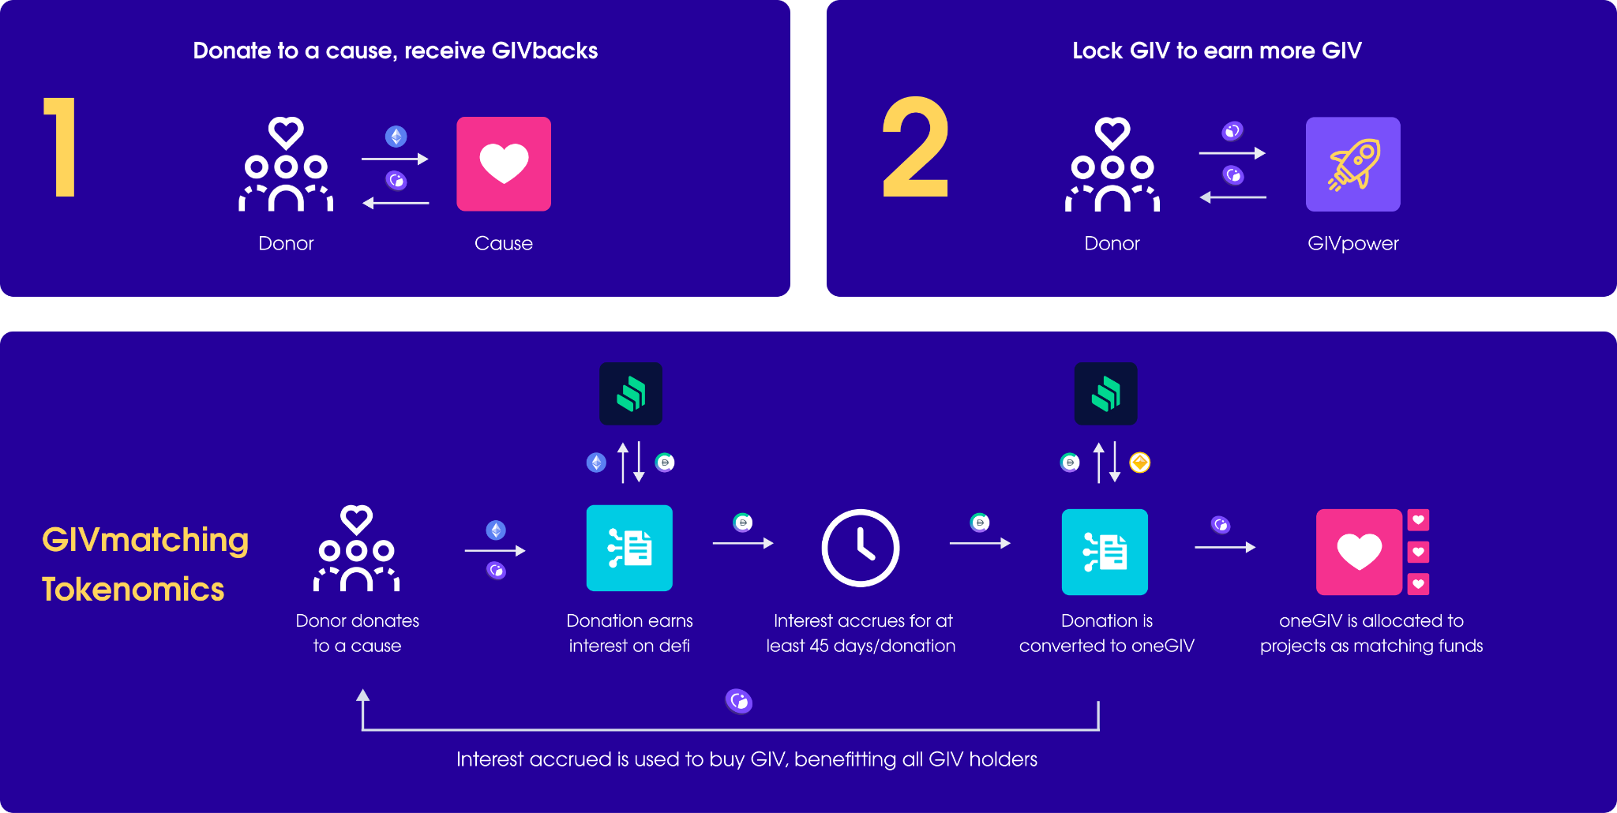
The GIVeconomy Future - next phase of the future of giving
GIVpower
Community members will be able to stake & lock GIV on their favorite projects on Giveth taking GIV out of circulation.
GIVmatching
Donation matching to projects on Giveth using "Causes" through quadratic funding.
Causes will be for-good initiative categories such as environmental regeneration, digital public goods, social causes, etc.
GIVfi
Create a sustainable way of maintaining funds in the GIVgarden common pool. Generating interest for Projects and Giveth, while donations on the DApp wait for disbursement.

Slide 16
GIVfi + GIVmatching

Slide 17


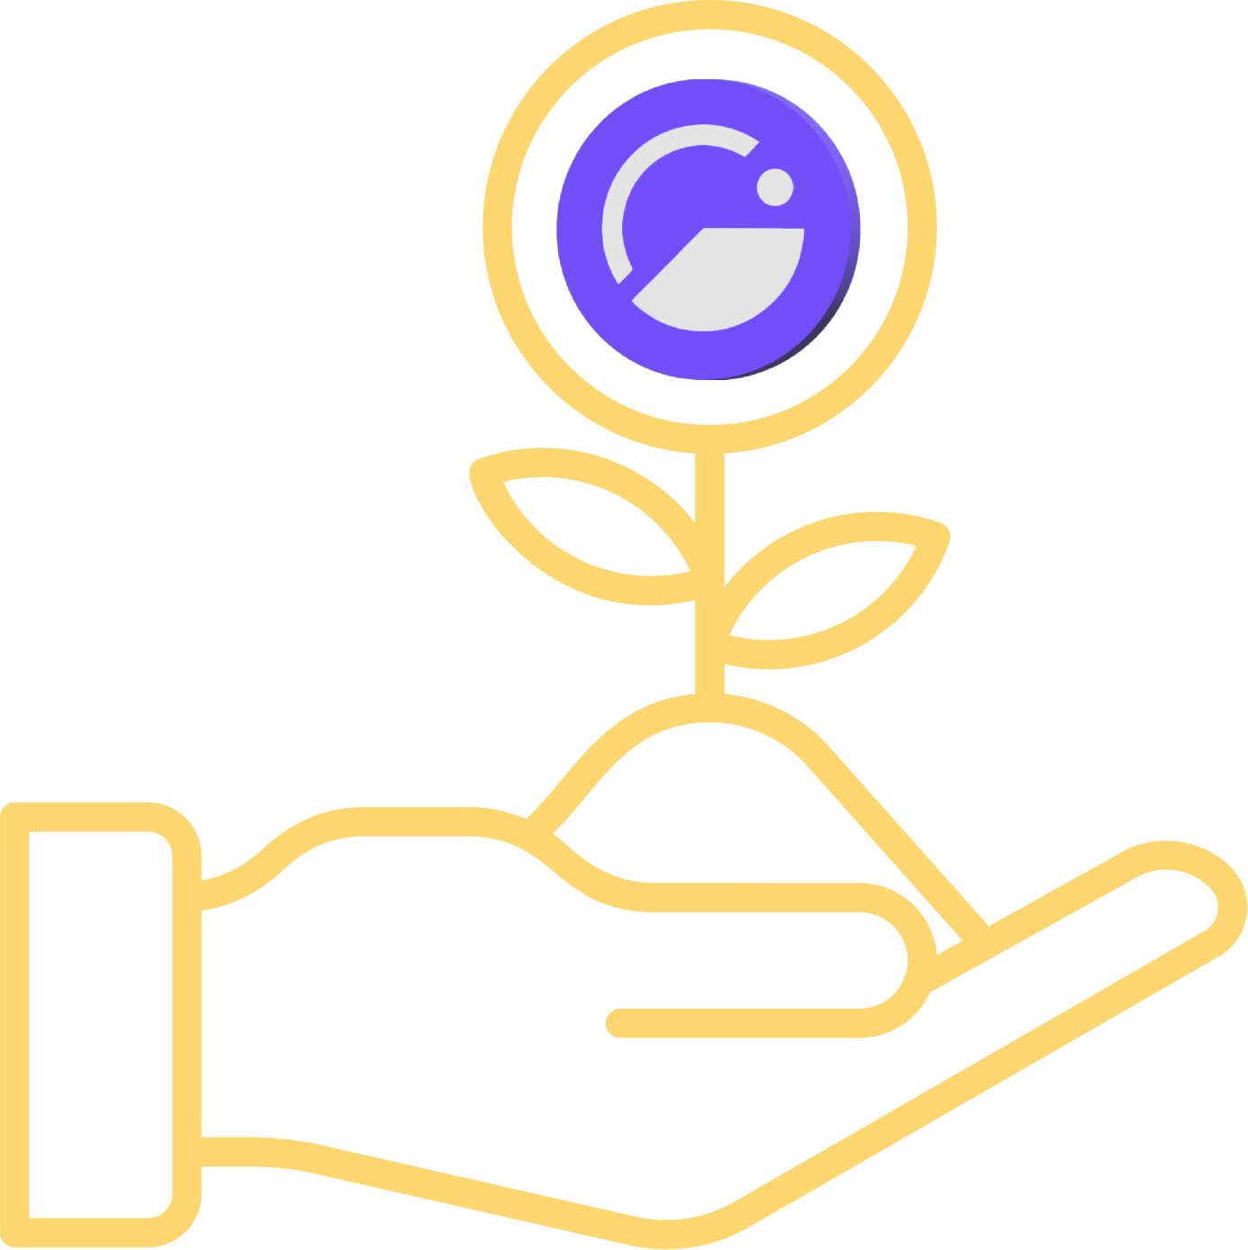
GIVfi
Bringing defi to nonprofits
Griff Green @thegrifft
Notes:
GIVbacks is a revolutionary concept that rewards donors to verified projects with GIV tokens. When you give to verified projects you get GIV tokens and you get a Stream of GIV tokens for the next 4 years. This means that not only does Giveth reward you for donating, if the GIV token price goes up, you could actually make more money than you donated! What more could you want?

Slide 18
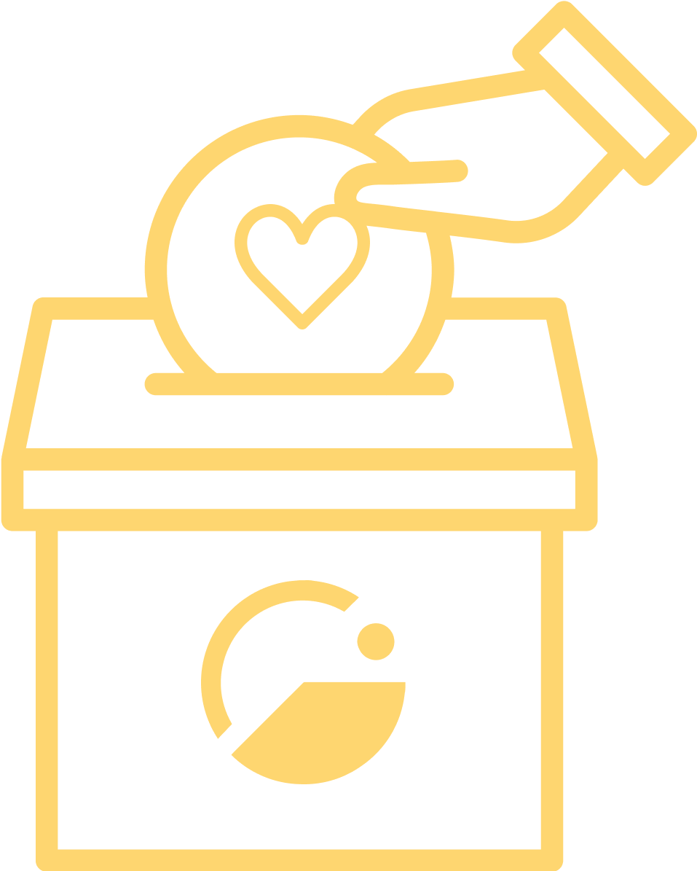

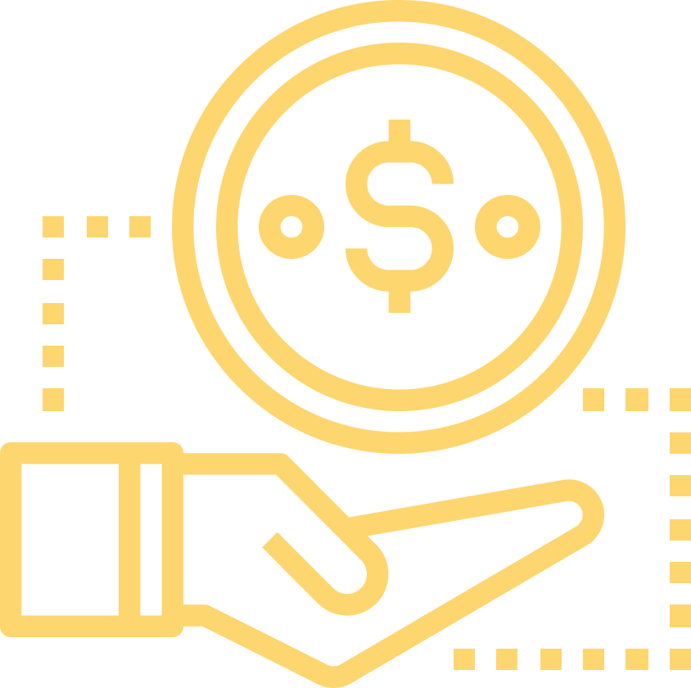
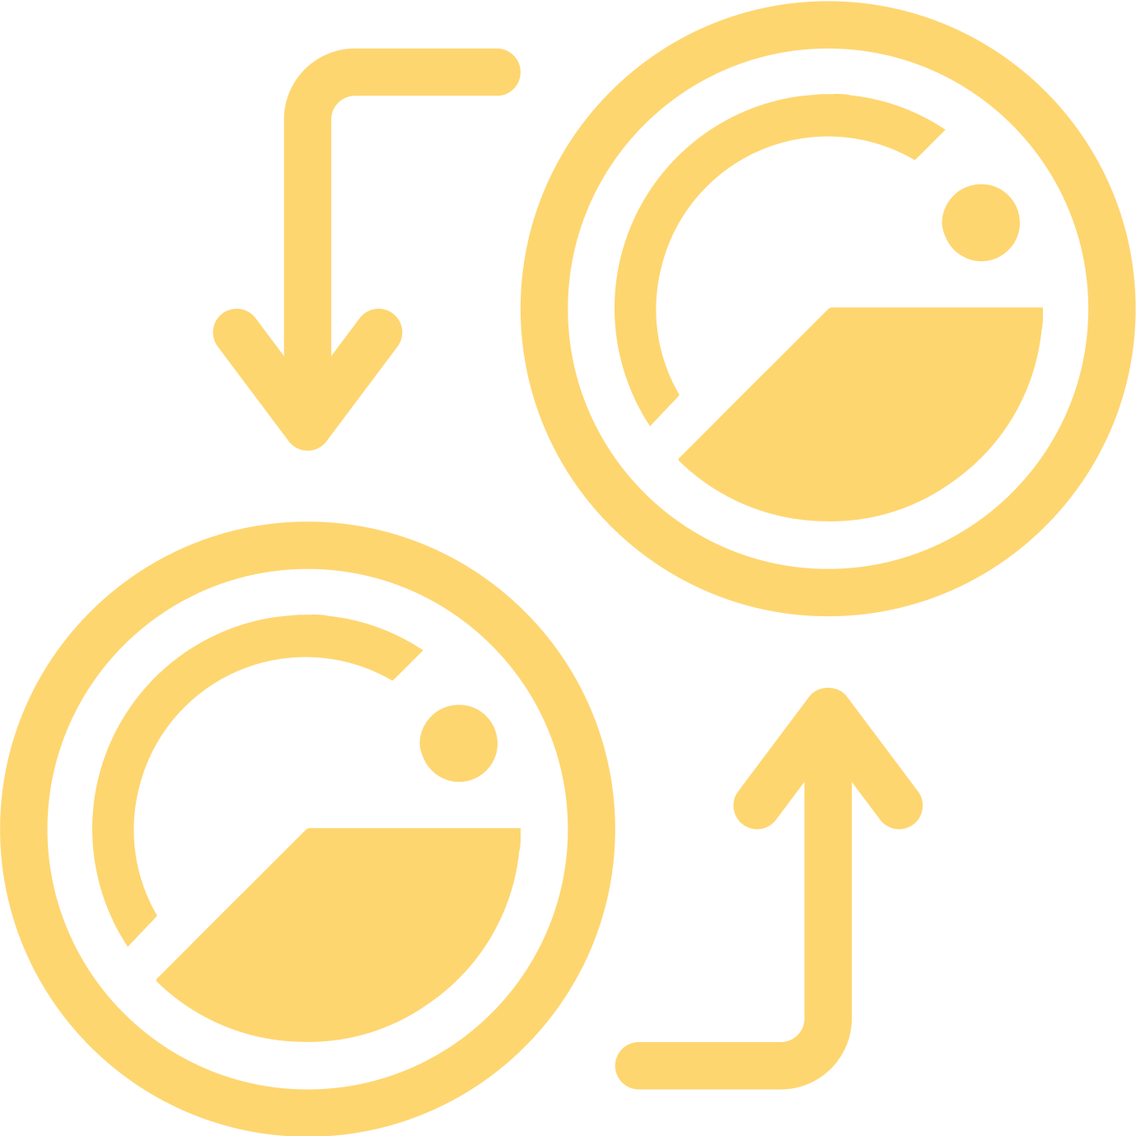
GIVfi has several pieces
Default of 5% of every donation donated to Giveth. (Can opt-out.)
Latent donations on Giveth earn interest on defi to buy GIV & become a high interest rate savings account for projects.
Mandatory Fee switch integrated to base layer controlled by GIV token holders.
oneGIV gets integrated into the system to create demand for GIV.
GIVfi brings revenue and economic demand for the GIV token, however, this is just the beginning.

Slide 19
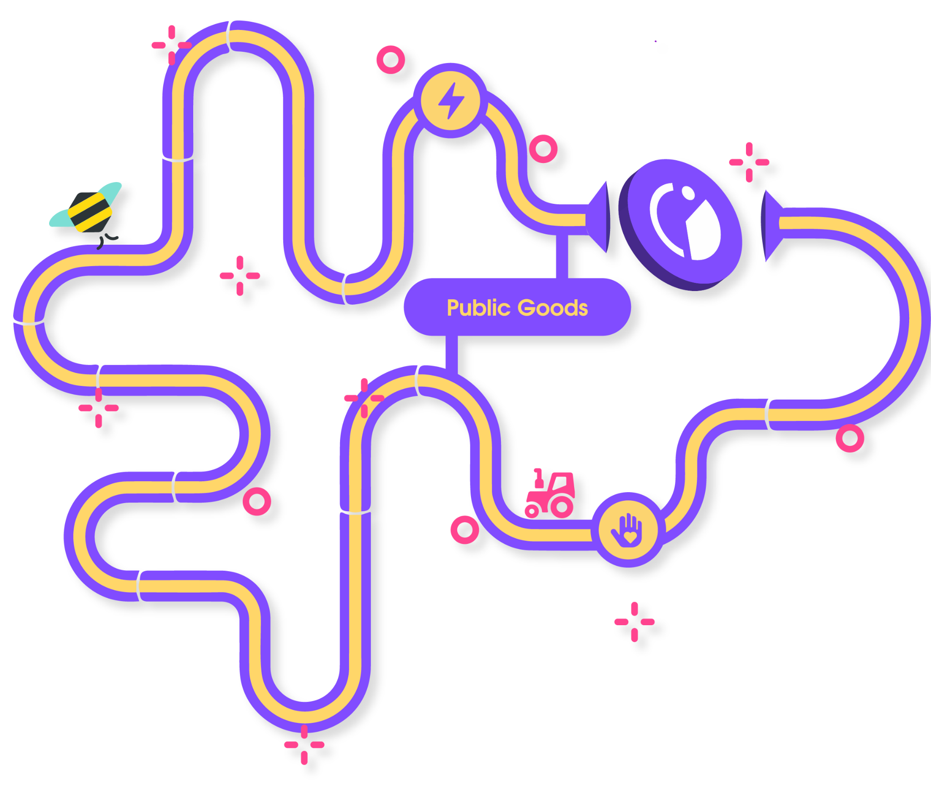

The Path to Gurves
Griff Green @thegrifft
Notes:
Gurves are the big dream of Giveth. Gurves turn donors into investors and volunteers into shareholders, coordinating all of the stakeholders around the nonprofit’s regen microeconomy. Ok i am going to skip over an explanation of Bonding how BC’s work… so if you don’t know, its ok, just believe me that this makes sense. Let’s say that Mutual Aid Mondays has ironed out the kinks around coordinating as a DAO with their reputation system and has become Mutual Aid Denver DAO and has 200k worth of GIVtokens staked behind it via GIVpower. They can start a Gurve.

Slide 20
Our growth plan - the best is yet to come
Angel Vault and path to our stable token (oneGIV)
To create more liquidity, we have launched oneGIV and the Giveth Angel Vault. This way we can protect the value of GIV for GIVbacks, the GIVgarden & all our future ventures. oneGIV is our own branded stablecoin and will be used throughout the GIVeconomy.
2022
GIVpower
GIV holders will be able to lock their tokens to BOOST projects asking for donations on our platform. The longer they lock, the more their favorite projects are BOOSTED and the higher their own staking APR.
2022
GIVfi
Fees will be integrated into the platform and latent donations on will be put into safe defi strategies to earn interest while waiting for projects to withdraw. This interest will be used to buy GIV on the open market.
2023
Gurves: Regen microeconomies powered by GIV
With the GIV staked behind projects via GIVpower, we can enable for-good projects to launch their own microeconomies backed by GIV in a bonding curve. Donors become investors, volunteers become shareholders with a voice, and Giveth.io becomes the place to go for seed round impact investments. The Future of Giving is Investing.
Future

Slide 21
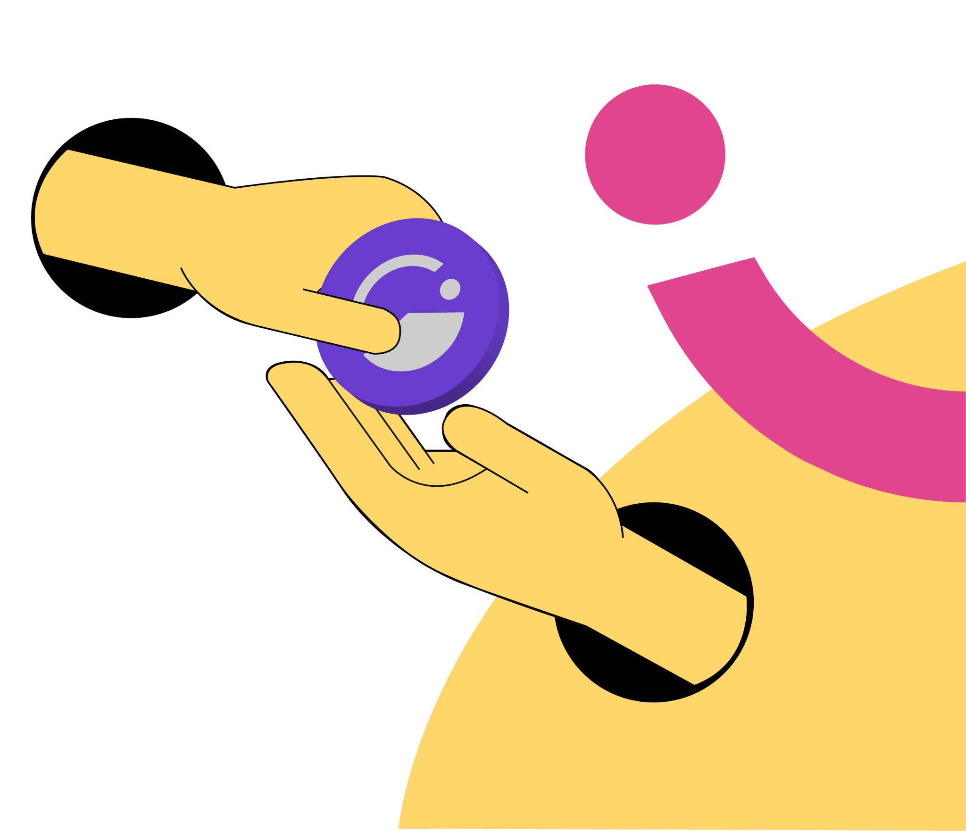
GIVbacks
Where giving gives back
Griff Green @thegrifft
Notes:
GIVbacks is a revolutionary concept that rewards donors to verified projects with GIV tokens. When you give to verified projects you get GIV tokens and you get a Stream of GIV tokens for the next 4 years. This means that not only does Giveth reward you for donating, if the GIV token price goes up, you could actually make more money than you donated! What more could you want?

Slide 22

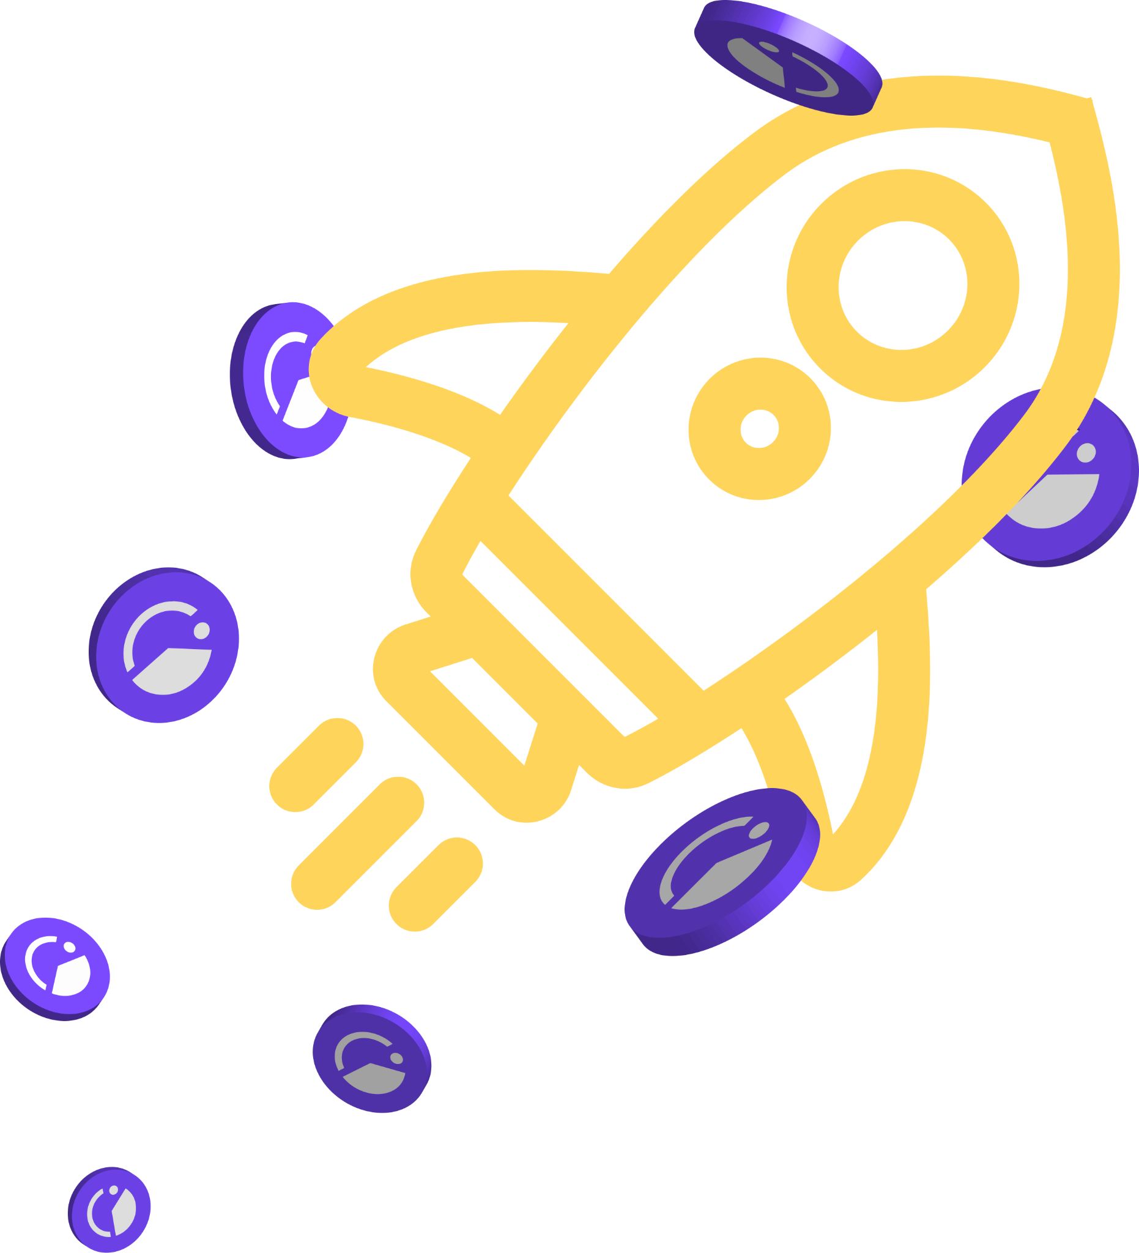
GIVpower
A win-win opportunity for donors & projects
Griff Green @thegrifft

Slide 23
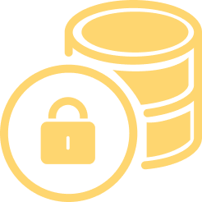


How does GIVpower work?
Stake & lock GIV to get GIVpower & earn a yield
Boost your favorite
projects
Donors to top projects get more GIVbacks
Griff Green @thegrifft
Notes:
Governance without voting…

Slide 24
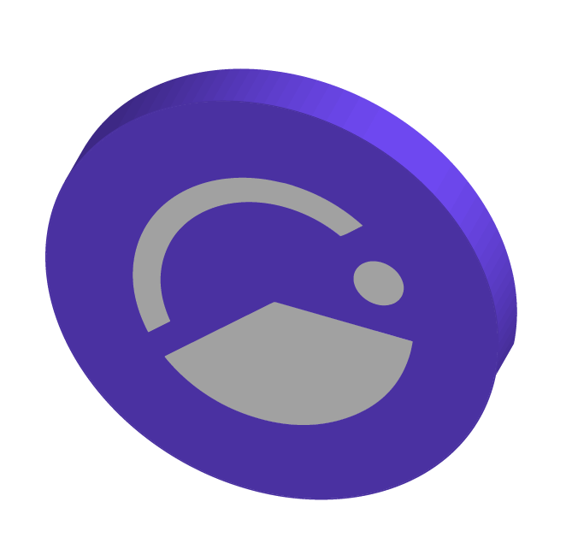
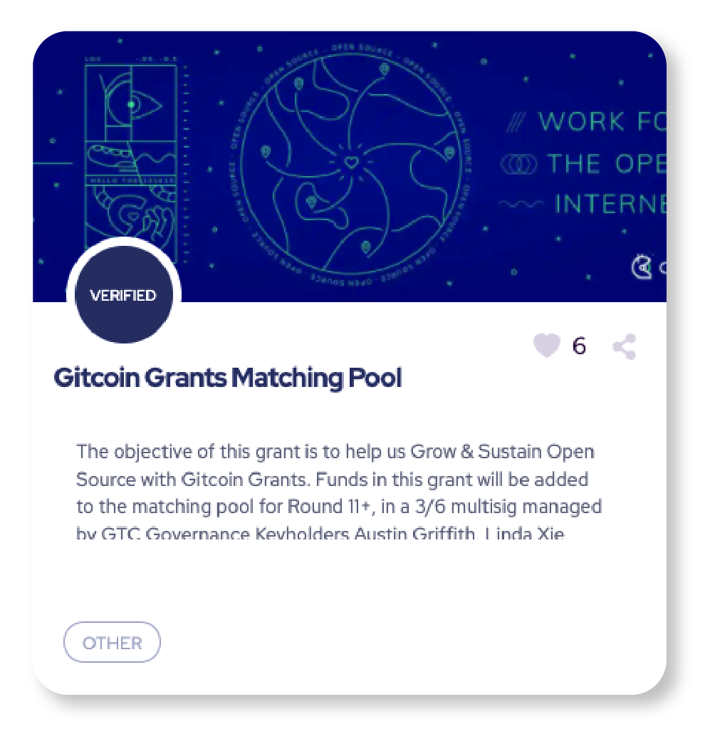
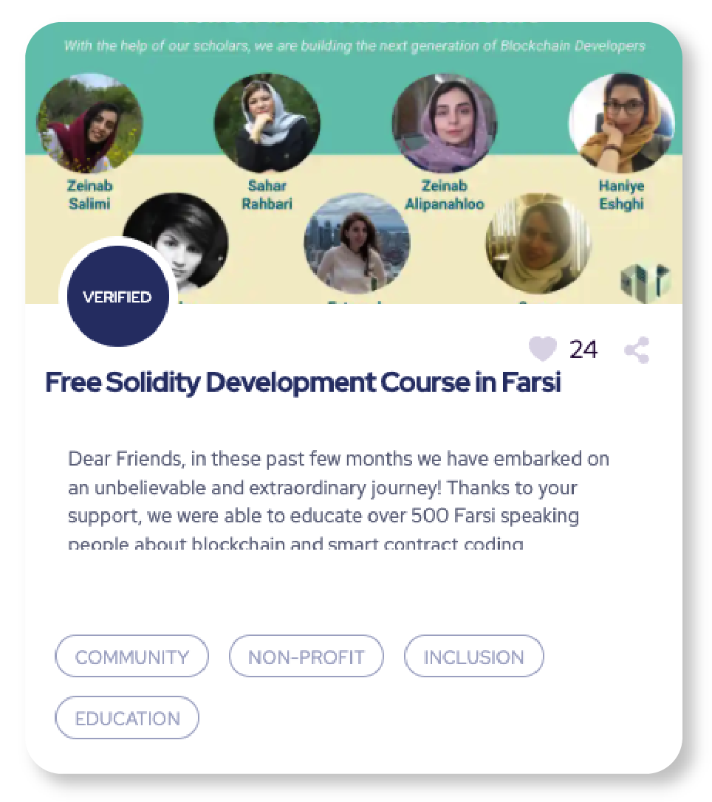
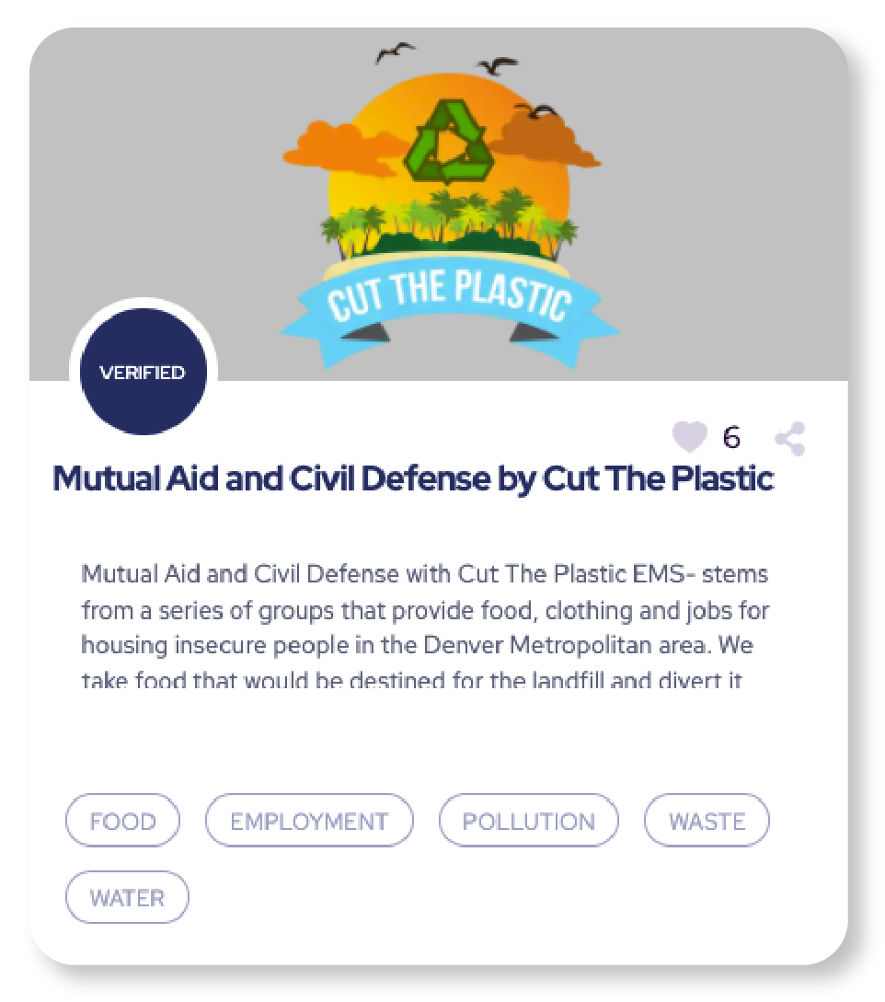
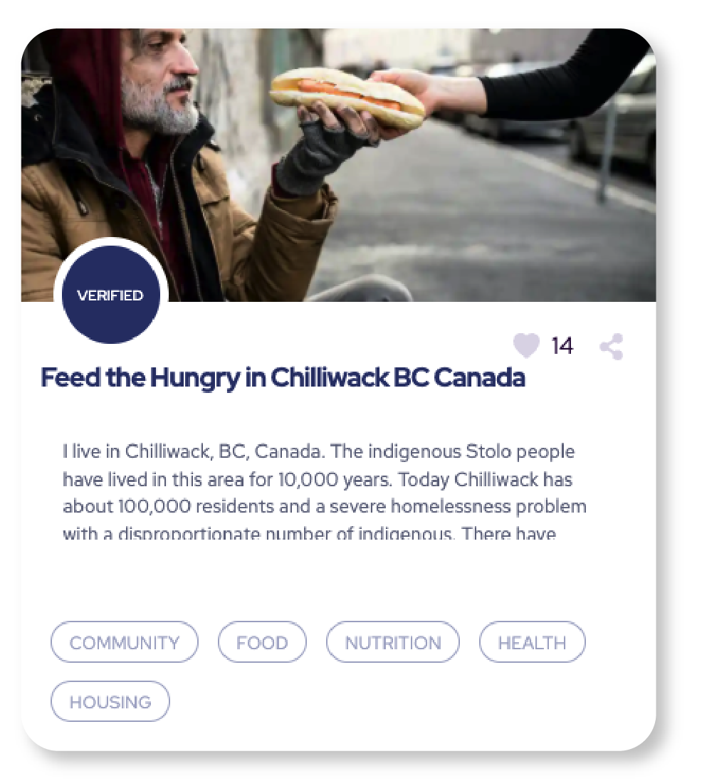
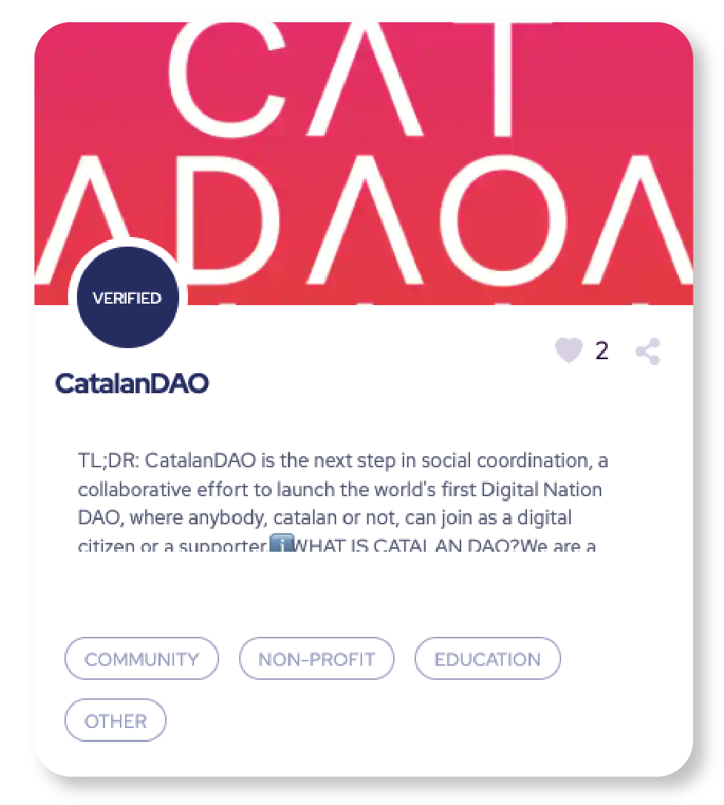
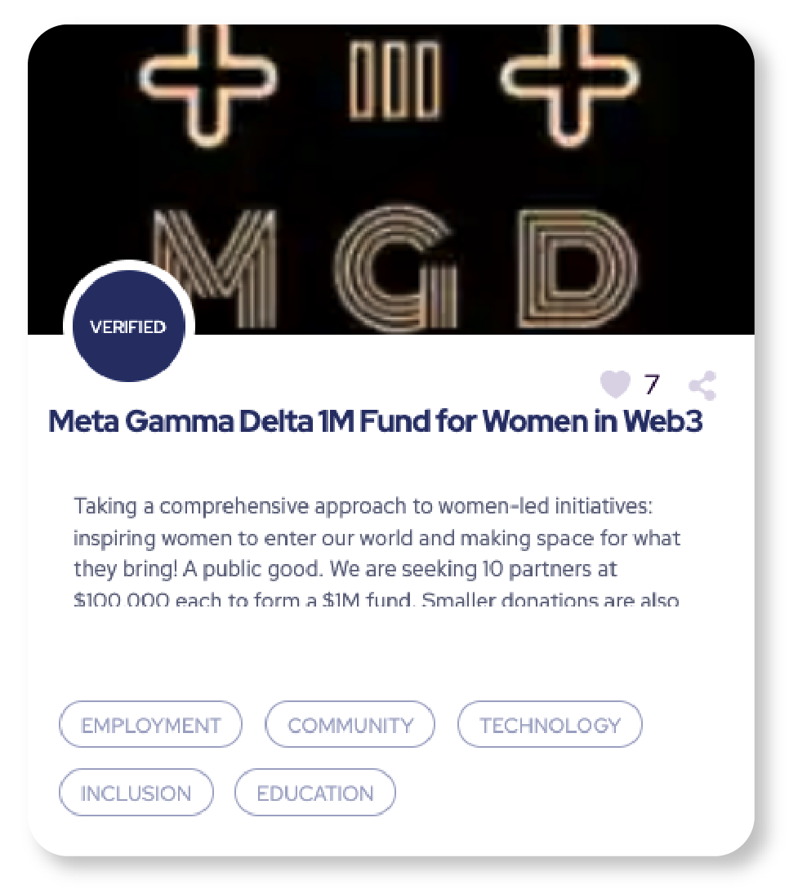



Projects
become Reputation DAOs
Griff Green @thegrifft
Notes:
When Projects on Giveth start to have a lot of GIV tokens staked behind them, we will reach out and help them create a rewards system so their community can learn to DAO. This will start out as just a reputation system, but it will allow the nonprofit to start to collectively implement their own economic game, they can start to give points to their underpaid staff and volunteers, their expert advisors, and their donors on Giveth. Every successful Regen economy will need to design a system that rewards expertse, labor and capital in the right balance. To be successful, and this is our current plan on how to kickstart it, for legacy nonprofits. Once the project has a working reputation system then they can start to collectively govern their donations via their very own DAO, and then if they are winning the GIVpower game, then we can bring out the GURVES!

Slide 25



Praise
Acknowledge and reward community contributions, and build a culture of giving and gratitude.
Notes:
Praise is a reward system that invites communities to build a culture of giving and gratitude, involving contributors at every step of the process.
Praise allows communities to acknowledge the full spectrum of value created - ranging from small to large contributions. With praise we are not locking a top down value system in place, but we are constantly listening to what the community does value.
Praise works in 4 steps

Slide 26
Gurves
Griff Green @thegrifft
Notes:
Gurves are the big dream of Giveth. Gurves turn donors into investors and volunteers into shareholders, coordinating all of the stakeholders around the nonprofit’s regen microeconomy. Ok i am going to skip over an explanation of Bonding how BC’s work… so if you don’t know, its ok, just believe me that this makes sense. Let’s say that Mutual Aid Mondays has ironed out the kinks around coordinating as a DAO with their reputation system and has become Mutual Aid Denver DAO and has 200k worth of GIVtokens staked behind it via GIVpower. They can start a Gurve.

Slide 27

Gurves are Only Given to the Best!
The projects with the most GIV locked behind them will be supported in DAOifying their project, first with a Reputation DAO, governing their donations. When that succeeds, and a strategy for creating demand for a token can be structured, then we will help that project launch a Gurve. This mimics a traditional investment pattern but with advanced token engineering patterns built in, for integrating donations and investments together.
GIVpower becomes seed collateral. The GIV locked behind the project can collateralize the issuance of a new token for the project via a Giveth bonding curve aka Gurve. These 1st supporters get discounted PROJ.
Hatch as a Series A. Additional capital for a project’s DAO can be raised right before launch. All $PROJ issued at launch will be locked.
$PROJ distributed fairly. The community supporting the project as a nonprofit has earned reputation tokens and will be given locked $PROJ. Labor, expertise and capital all have upside and shared success.
Continuous Series B. Anyone can now invest into the DAO by sending GIV to the Gurve to issue liquid PROJ, raising the price of PROJ.

Slide 28

Griff Green @thegrifft
Notes:
Let’s assume a Bancor style bonding curve with a reserve ratio of 20% (liek what the TEC has) this means that the 200k worth of GIVtokens would collateralize a $1million dollars worth of Mutual Aid tokens. So now with that $1 million dollars, lets just do simple math and give ⅓ of to the GIVpower stakers and ⅓ of it to the reputation holders and 1/3rd of it to the Mutual Aid DAO itself. There is a lot of nuance her that I am skipping and we are learning about via the Commons Stack’s applied research… but in the interest of time, i will continue.

Slide 29

Gurves
Griff Green @thegrifft
Notes:
Gurves are the big dream of Giveth. Gurves turn donors into investors and volunteers into shareholders, coordinating all of the stakeholders around the nonprofit’s regen microeconomy. Ok i am going to skip over an explanation of Bonding how BC’s work… so if you don’t know, its ok, just believe me that this makes sense. Let’s say that Mutual Aid Mondays has ironed out the kinks around coordinating as a DAO with their reputation system and has become Mutual Aid Denver DAO and has 200k worth of GIVtokens staked behind it via GIVpower. They can start a Gurve.

Slide 30

Griff Green @thegrifft
Notes:
Gurves are the big dream of Giveth. Gurves turn donors into investors and volunteers into shareholders, coordinating all of the stakeholders around the nonprofit’s regen microeconomy. Ok i am going to skip over an explanation of Bonding how BC’s work… so if you don’t know, its ok, just believe me that this makes sense. Let’s say that Mutual Aid Mondays has ironed out the kinks around coordinating as a DAO with their reputation system and has become Mutual Aid Denver DAO and has 200k worth of GIVtokens staked behind it via GIVpower. They can start a Gurve.

Slide 31

Gurves The Future of Giving is Investing
Gurves will transform Giveth from a donation platform into an impact investment platform. Innovators in the nonprofit space will be able to capitalize on their idea and find seed capital on the platform to create their own token, collateralized by GIV.
Traditional foundations will have an opportunity to diversify their endowments into novel impact investments. There were over $1.7 TRILLION USD in endowments in 2017 in the US alone, and the number has likely grown since then. If only ¼ of a percent of these funds allocated to Impact DAOs on our platform, this would be over $4 billion USD of demand for GIV.
And that is only one of many potential organizations that would have an opportunity to invest instead of donate in their favorite nonprofit causes.
Griff Green @thegrifft
Notes:
Gurves are the big dream of Giveth. Gurves turn donors into investors and volunteers into shareholders, coordinating all of the stakeholders around the nonprofit’s regen microeconomy. Ok i am going to skip over an explanation of Bonding how BC’s work… so if you don’t know, its ok, just believe me that this makes sense. Let’s say that Mutual Aid Mondays has ironed out the kinks around coordinating as a DAO with their reputation system and has become Mutual Aid Denver DAO and has 200k worth of GIVtokens staked behind it via GIVpower. They can start a Gurve.

Slide 32
We are raising $3-5 mil USD
We are offering a chance to participate in this round soon in the following ways:
Buy GIV at a discounted rate, and stake it with a higher reward in GIVpower while retaining governance.
Giveth Success Tokens - these are "crypto native convertible debt" which provide extra value to the investor when the token price rises above the strike value. Read more.
And more - We want to work with YOU to structure this opportunity. We are builders and need the investment perspective to finalize the structure of the offer.

Slide 33

Join us in Building the
Future of Giving

Slide 34
APPENDIX
GIVeconomy & Token info
GIVdrop
GIVbacks
GIVstream
GIVgarden
Regen farms

Slide 35


Giveth offers lucrative rewards to donors while attracting and rewarding long-term holders
The GIVfarm provides various liquidity farms on Mainnet and Gnosis Chain - as well as single asset GIV staking on Gnosis Chain.
The APRs are high without hurting our economy in the short term because of our GIVstream. When you harvest rewards from the GIVfarm you are not only earning instantly claimable rewards but also receiving and augmenting your own personal continuous stream of GIV.

Slide 36

GIV is the governance token that fuels and directs the GIVeconomy
Our community can participate in the GIVeconomy in the following ways:
From December 24, 2021 onward, eligible recipients can claim their GIVdrop on Gnosis Chain.
Donors to verified projects on Giveth get rewards from GIVbacks.
Liquidity providers and stakers can earn rewards in the GIVfarm.
All GIV holders can create and/or vote on proposals in the GIVgarden.
Anyone who claims GIV from their participation in the GIVeconomy gets a continuous flow of GIV from the GIVstream until December 23, 2026.
An amount of 1 billion GIV tokens were minted at the onset of the GIVeconomy. 90% of the GIV was put into the GIVstream and is being released continuously throughout the entire "GIViverse" over a period of 5 years (until December 23, 2026).
The distribution of the total supply of GIV throughout the GIViverse

Slide 37

The GIVstream aligns community members with the long term success of Giveth and the GIVeconomy
With the GIVstream, anyone who adds value to the GIVeconomy receives GIV continuously for up to 5 years from the GIVeconomy launch date.
GIV is rewarded through participation in the GIVeconomy, part will be liquid and part will add to GIVstream flowrate. As the GIVeconomy grows & stabilizes, more GIV becomes liquid and available for everyone.
GIVstream flowrate is the rate (GIV/week) at which GIV becomes liquid.
On Gnosis Chain, GIVstream flowrates are given (or increased) by donating and getting GIVbacks, wrapping GIV to use in the GIVgarden, or staking in the GIVfarm. On Ethereum mainnet by providing mainnet liquidity and staking GIV or LP tokens in the GIVfarm on Mainnet.
The GIVstream nurtures the GIVeconomy at inception by having only 10% of the total supply of GIV liquid and transferrable to start.

Slide 38
The GIVgarden, the DAO governance platform
Giveth has chosen the Gardens DAO governance platform developed in partnership with 1hive to allow GIV token holders to manage the DAO configurations and allocate funds to projects that are aligned with its mission, vision and values.
The main tools used for governance in the GIVgarden are Conviction Voting and Tao Voting.
The unique feature of Conviction Voting is that, instead of voting yes or no on proposals, you stake GIV behind proposals that align with your values.
Tao Voting is a YES/NO decision making tool, with the option of delegation, that is used in the GIVgarden to make important, non-financial decisions for the DAO: updating DAO parameters, fixing bugs, adding new features to the DAO and/or for emergency situations such as an attack to the DAO treasury.

Slide 39
The next generation of ReFi Opportunities
Giveth is re-engineering charitable giving by creating a free, open-source platform, built on Ethereum and compatible with any EVM-Chain.
RegenFarms is the next generation of ReFi liquidity mining opportunities for DAOs and regens alike. Using our contracts for the GIVfarm and the GIVstream, we are empowering other for-good DAOs to launch liquidity mining incentive programs, “RegenFarms”, with streams of their own.
Shapeshift, CultDAO & recently The Standard have all paid to be part of this program.

Slide 40


RegenFarms presents the next generation of ReFi liquidity mining
Using our contracts for the GIVfarm and the GIVstream, we are empowering other for-good DAOs to launch liquidity mining incentive programs, “RegenFarms”, with streams of their own.
How?
Utilizing the GIVstream, all rewards earned in the GIVfarm (until December 23, 2026) include some part liquid and some part streaming. This allows the GIVfarm to offer high APRs without creating excessive sell pressure. Thanks to the GIVstream, Giveth has pioneered an elegant evolution to traditional liquidity mining that offers lucrative rewards while attracting and rewarding long-term hodlers, and keeping participants invested in the project for years to come.
We are now offering this technology as a service to other Blockchain4Good DAOs.
Shapeshift and CULTDAO’s RegenFarm are open for deposits and earning rewards.

